Slide 1

The role of stress-induced mutation in the emergence of complex adaptations
Yoav Ram & Lilach Hadany
SIDEER Symposium 2013
Sede Boqer, Israel

Slide 2




Acknowledgments
Dr. Lilach Hadany
https://sites.google.com/site/hadanylab
The George S. Wise Faculty of Life Sciences
The Department of Molecular Biology and Ecology in Plants
Amalia Biron-Zigle
Foundation
Presentation & code available online at: http://sideer2013.yoavram.com

Slide 3

Mutation
“Mutations … supply the raw materials for evolution”
Dobzhansky, Genetics and Origin of Species 1937
“Mutation is the ultimate source of variation on which natural selection acts”
Lynch, 2007

Slide 4



Variation in mutation rates
Between species
“Noticeable” mutations per genome per generation
Mammals (H. sapiens): 41 (Lynch PNAS 2010)
Flies (D. melanogaster): 0.455 (Keightley et al. 2009)
Bacteria (E. coli): 0.003 (Drake 1991)

Slide 5

Variation in mutation rates
Between populations
Mutation rate of 69 natural isolates of E. coli - Matic et al. 1997

Slide 6

Variation in mutation rates
Within individuals
Error rates DNA polymerases – Lynch 2011

Slide 7

Stress-induced mutation
Rosenberg et al. 2012
E. coli:
Error prone DNA polymerases are induced by stress responses:
SOS response
Carbon starvation
DNA damage

Slide 8


C. reinhardtii
Evidence
Bacteria
Escherichia coli Bjedov et al. 2003
Bacillus subtilis Sung and Yasbin 2002
Pseudomonas putida Kivisaar 2010
Pseudomonas aeruginosa Weigand & Sundin 2012
Listeria monocytogenes van der Veen et al. 2010
Staphylococcus aureus Cirz et al. 2007
Mycobacterium tuberculosis Boshoff et al. 2003
Eukaryote
Chlamydomonas reinhardtii Goho & Bell 2000
Saccharomyces cerevisiae Hall 1992; Heidenreich 2007
Caenorhabditis elegans & briggsae Matsuba et al. 2012
Drosophila melanogaster Sharp & Agrawal 2012
Human cancer cells Hara et al. 2005; Bristow & Hill 2008
Reviewed by Foster 2007; Galhardo et al. 2007; Rosenberg et al. 2012; Poole 2012
B. subtilis

Slide 9

Evolution of Stress-Induced Mutation
Null Hypothesis: mutation is a by-product of stress
Alternative, non-adaptive hypotheses:
Cost of DNA replication fidelity (Dawson 1998)
Drift barrier hypothesis (Lynch 2010, 2011)
Adaptive hypothesis:
“…the evolutionary consequence of SIM is that bacteria are able to adapt rapidly to stressful environments…”
MacLean et al. 2013

Slide 10
Overview
Evolution of stress-induced mutation:
Deterministic model for a constant environment
Stochastic model for a changing environment
Effect of stress-induced mutation on:
Emergence of complex adaptations
Ram & Hadany, Evolution 2012

Slide 11
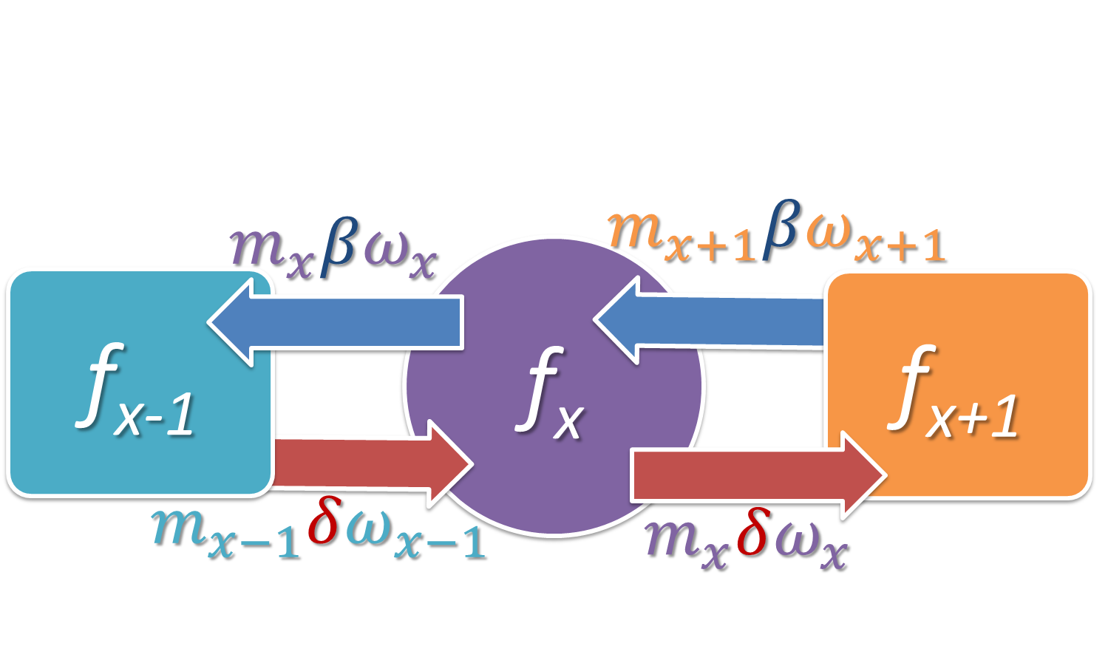
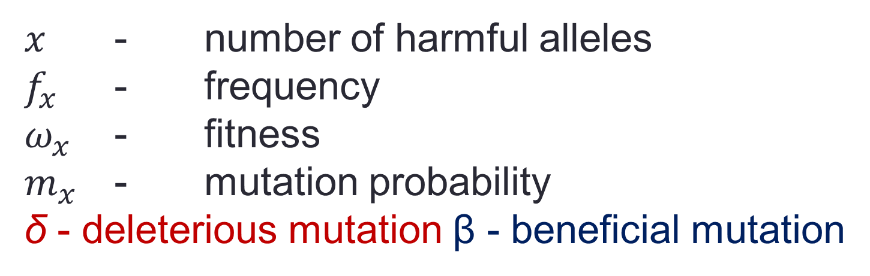
Constant environment, steady state
$x$ - number of harmful alleles
$f_{x}$ - frequency
$ω_{x}$ - fitness
$m_{x}$ - mutation probability
δ - deleterious mutation β - beneficial mutation

Slide 12
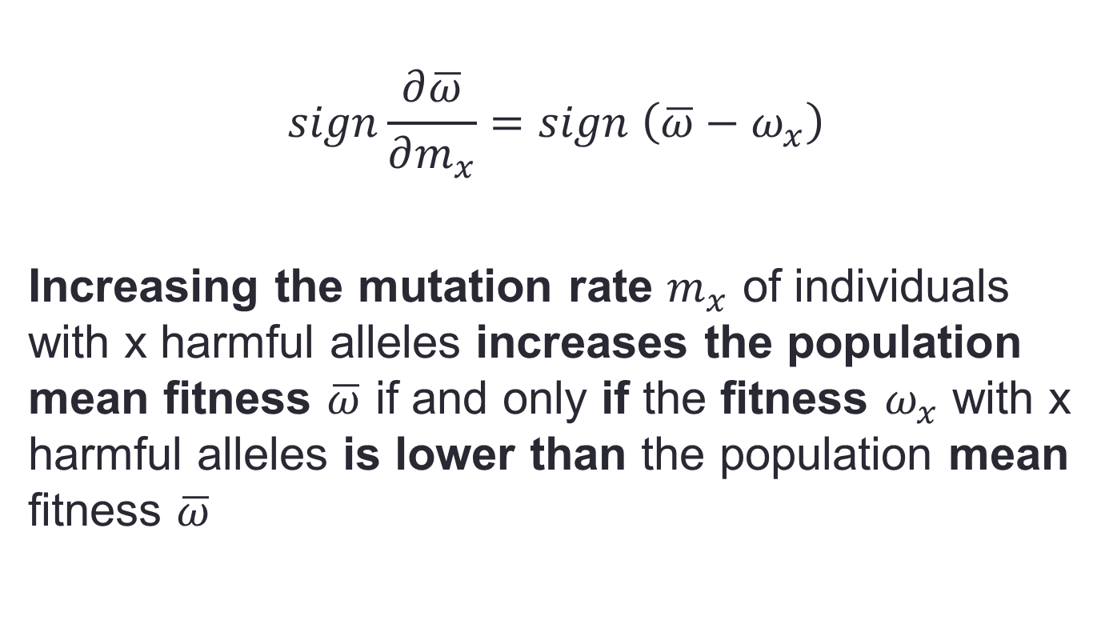
The unfit should hypermutate
$$sign\frac{∂\overline{ω}}{∂m_{x}}=sign \left(\overline{ω}−ω_{x}\right)$$
Increasing the mutation rate $m_{x}$ of individuals with x harmful alleles increases the population mean fitness $\overline{ω}$ if and only if the fitness $ω_{x}$ with x harmful alleles is lower than the population mean fitness $\overline{ω}$

Slide 13


Advantage to SIM
SIM vs. NM
NM - Non-mutators
constant low rate of mutation
CM - Constitutive mutators
Constant high rate of mutation
SIM - Stress-induced mutators
Low mutation rate when well-adapted
High mutation rate when stressed
No Beneficial Mutations
Relative Fitness Advantage
CM vs. NM
Mutation Rate Increase

Slide 14

Changing environment, competitions
SIM Wins
SIM Loses
Notes:
SIM π=1 τ=10 vs. CM τ=10; 60 replicates, SIM starts at 5% and wins in 40% (25/60, P<10⁻¹⁶)

Slide 15

SIM wins all competitions
Notes:
SIM vs. CM, up to 500 generations, SIM starts at 5%, # replicates>100, µ=0.003, error bars: ±1 SE, P<0.001

Slide 16
Evolution of Stress-Induced Mutation
Summary
Stress-induced mutation rate favored by selection over constant mutation rate
Both in changing and constant environments
Due to its effect on evolvability
Ram & Hadany, Evolution 2012

Slide 17
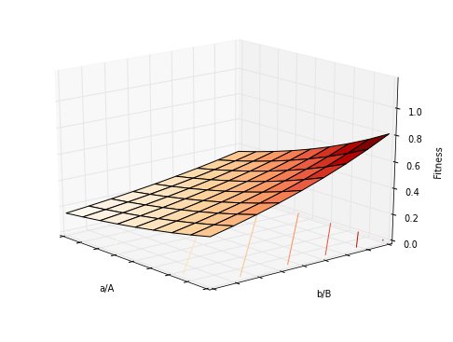
Smooth Fitness Landscape
Fitness:
ab (1-s)²
Ab 1-s
aB 1-s
AB 1

Slide 18
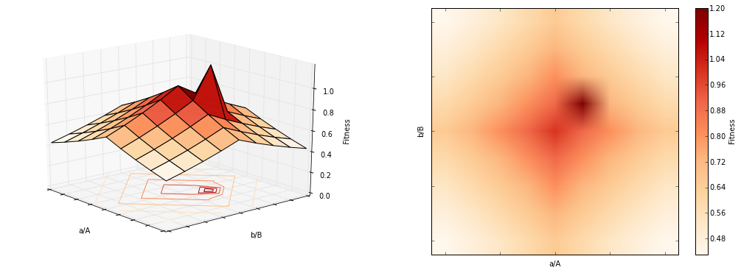
Rugged Fitness Landscape
Fitness:
ab 1
Ab 1-s
aB 1-s
AB 1+s

Slide 19
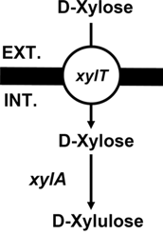
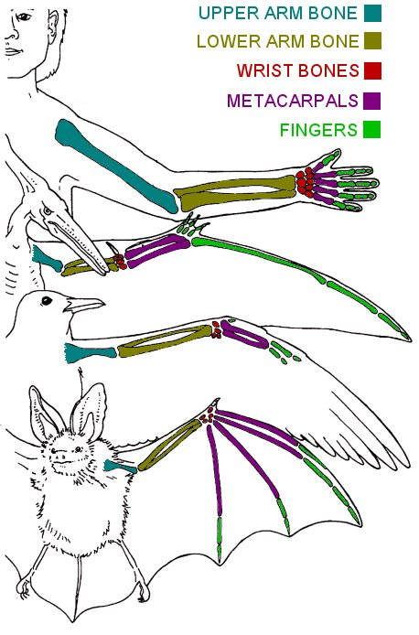
Rugged landscape example
Criteria
Two traits must change for adaptation
Changing a single trait leads to decreased fitness
New carbon source
Two new proteins required, but each is costly on its own:
Pump to transport new sugar into cell
Enzyme to metabolize sugar
Signaling and language
Broadcasting when no one can listen in costly
Receiving wen no one is broadcasting is costly
Wings and bones
Flying with heavy bones is hard
Light bones without flying is risky
Xiao et al. 2011
warksbats.co.uk

Slide 20
Shifting a fitness peak
High peak
Fitness:
ab 1
Ab 1-s
aB 1-s
AB 1+s
Low peak
Valley

Slide 21
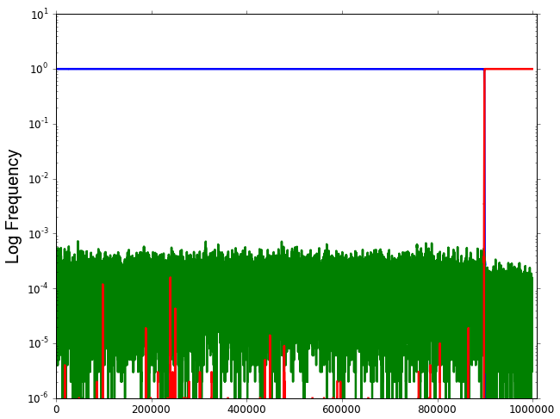
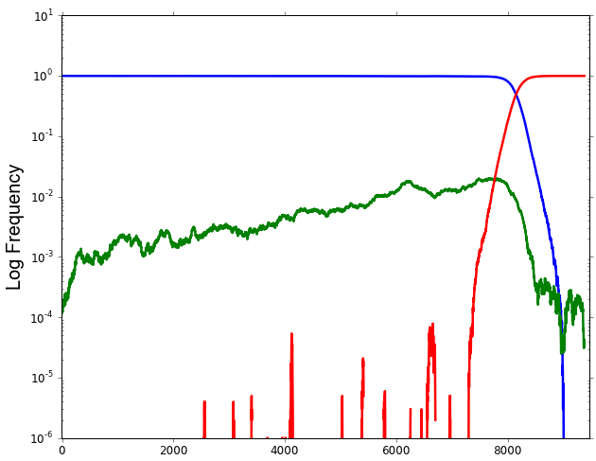
Adaptation on Fitness Landscapes
Wild type (ab)
Double mutant (AB)
Smooth Landscape
Single mutant (aB+Ab)
7,000 generations
WT (ab)
Single mutant (aB+Ab)
90,000 generations
Rugged Landscape
Double mutant (AB)
Notes:
N=10^7, s=0.01, H=1, U=0.003, u=U/5000

Slide 22
Stress-induced mutation on rugged landscapes
Mutation rate increased in individuals below the peaks
Low mutation rate
High mutation rate

Slide 23
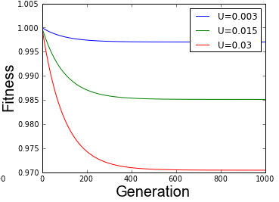
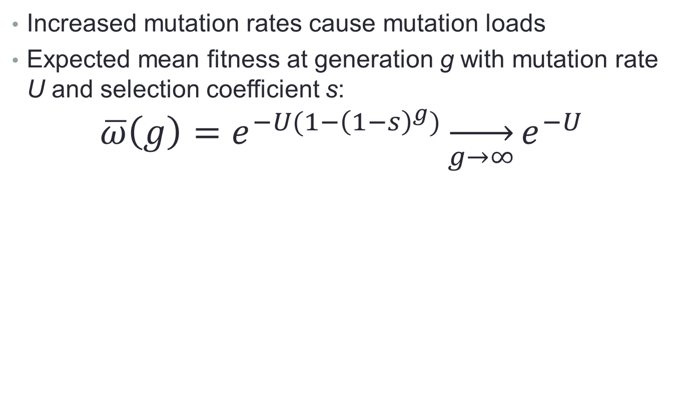
Mutational load
Increased mutation rates cause mutation loads
Expected mean fitness at generation g with mutation rate U and selection coefficient s:
$$\overline{ω}\left(g\right)=e^{−U(1−{\left(1−s\right)}^{g})}\overset{→}{g→∞}e^{−U}$$
Gordo & Dionisio 2005, Blog post

Slide 24
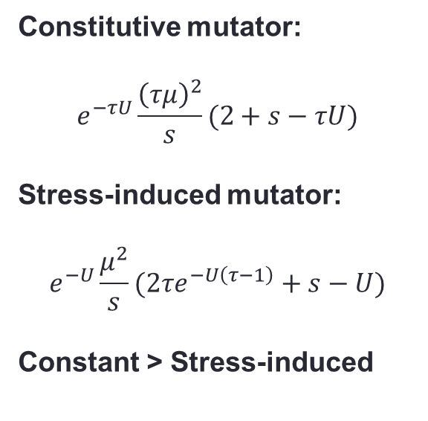
Appearance of a double mutant
The probability of the appearance of a double mutant
Constitutive mutator:
$$e^{−τU}\frac{{\left(τμ\right)}^{2}}{s}(2+s−τU)$$
Stress-induced mutator:
$$e^{−U}\frac{μ^{2}}{s}(2τe^{−U\left(τ−1\right)}+s−U)$$
Constant > Stress-induced
ab
AB
aB+Ab

Slide 25
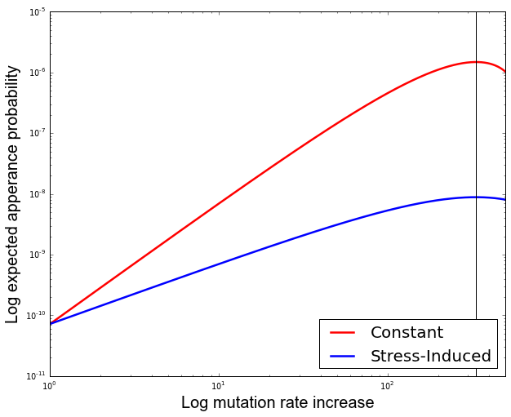
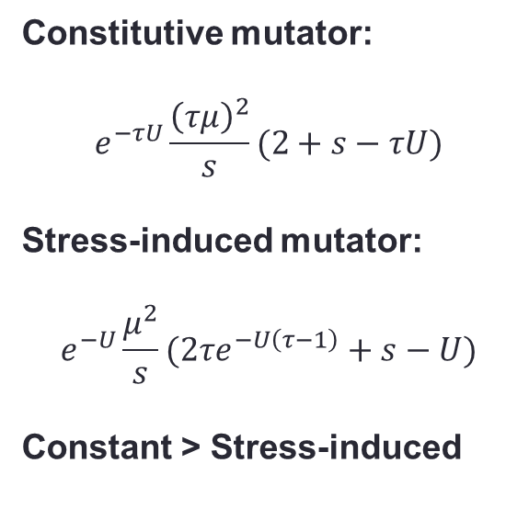
Appearance of a double mutant
The probability of the appearance of a double mutant
Constitutive mutator:
$$e^{−τU}\frac{{\left(τμ\right)}^{2}}{s}(2+s−τU)$$
Stress-induced mutator:
$$e^{−U}\frac{μ^{2}}{s}(2τe^{−U\left(τ−1\right)}+s−U)$$
Constant > Stress-induced

Slide 26
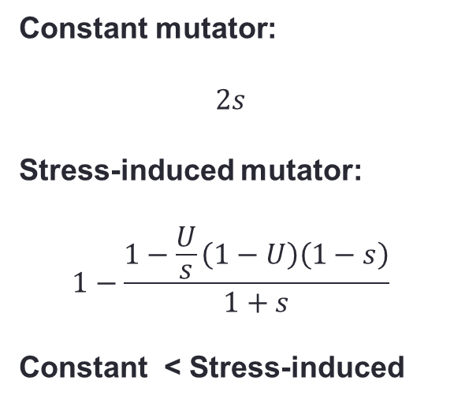
Fixation of a double mutant
The probability of the fixation of a double mutant
Constant mutator:
$$2s$$
Stress-induced mutator:
$$1−\frac{1−\frac{U}{s}\left(1−U\right)\left(1−s\right)}{1+s}$$
Constant < Stress-induced
ab
AB
aB+Ab

Slide 27
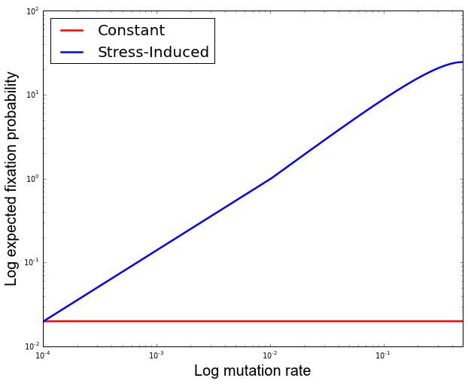
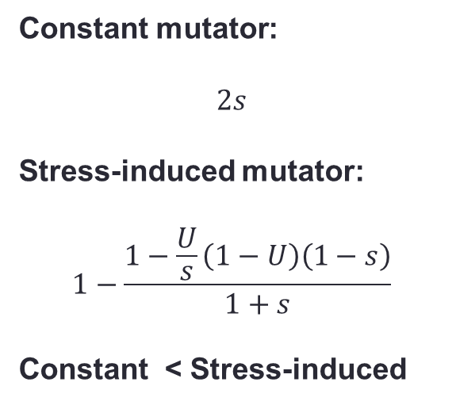
Fixation of a double mutant
The probability of the fixation of a double mutant
Constant mutator:
$$2s$$
Stress-induced mutator:
$$1−\frac{1−\frac{U}{s}\left(1−U\right)\left(1−s\right)}{1+s}$$
Constant < Stress-induced

Slide 28
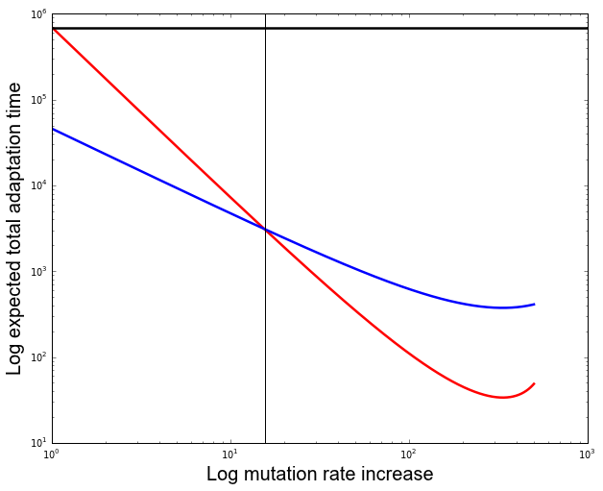
Total adaptation time
= Waiting time / fixation probability
15.5
Non-mutator
For weak mutation rate increases, adaptation time shorter for stress-induced mutator
Stress-induced mutator
Constitutive mutator

Slide 29
Competition before fixation
The time before a double mutant starts fixation is long
Fixation time
ab
AB
aB+Ab
Waiting time

Slide 30
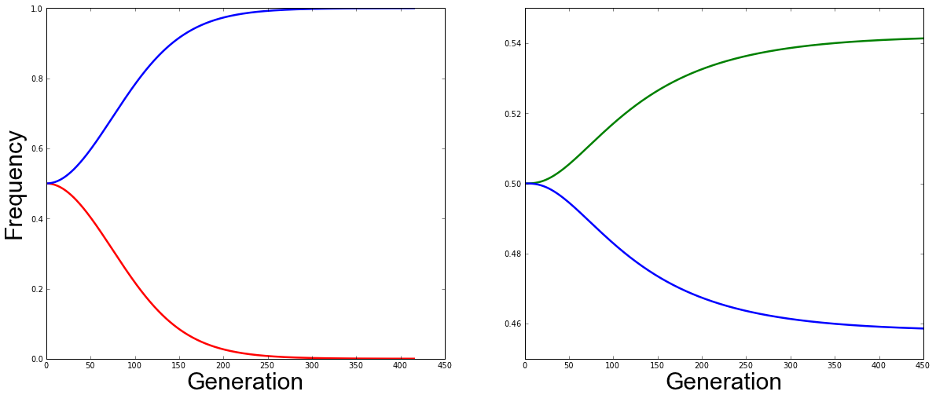
SIM outcompetes CM
During this time stress-induced mutators outcompete constitutive mutators
Stress-induced mutators co-exist with non-mutators
Non- mutator
Stress-induced mutator
Constitutive mutator
Stress-induced mutator

Slide 31



Summary
Stress-induced mutation accelerates adaptation on rugged fitness landscapes
With low increases of mutation rates, stress-induced mutators are better than constitutive mutators
During the long waiting time for adaptation stress-induced mutators outcompete constitutive mutators
yoavram@post.tau.ac.il
@yoavram
http://www.yoavram.com

